Slide 1



TRAINER STATISTICS
PROJECT OVERVIEW
Work by:
Soumya S

Slide 2
PROBLEM STATEMENT
Allocate trainers to in-house and corporate training based on demand and duration.
Match skill sets of trainers with requirements.
Fulfill training requirements efficiently.
Identify up-skilling needs based on unmet requirements.

Slide 3


DATA COLLECTION
Data Sources:
Trainers: Information about trainers' skill sets, work experience, and employee type.
Companies: Details on companies, expected start dates, duration of training, and the number of trainers required.
Trainer Allocations: Records of trainer allocations, start dates, and status of requirements (fulfilled/unfulfilled).

Slide 4
Data Collection Method:
Data was collected from Excel sheets named 'Trainer', 'Companies', and 'TrainerAllocation'.
DATA COLLECTION

Slide 5

DATA CLEANING
Missing Values:
Checked for null values and filled them with empty strings.
Data Types:
Converted date columns to datetime format.
Integrity Checks:
Ensured data validity by summarizing data and checking for inconsistencies.
Storing:
Stored cleaned data in Pandas DataFrames.

Slide 6
EXPLORATORY DATA ANALYSIS
Key Insights:
Analyzed work experience distribution among trainers.
Assessed the demand for specific technologies.
Examined skill sets of trainers.
Investigated the fulfillment status of training requirements.

Slide 7
TECHNOLOGY STACK
Python Libraries:
Pandas: Data loading, cleaning, and manipulation.
NumPy: Handling numerical data.
Matplotlib & Seaborn: Creating visualizations.
Scipy: Applying mathematical formulas.
Scikit-learn: Building and evaluating machine learning models.

Slide 8
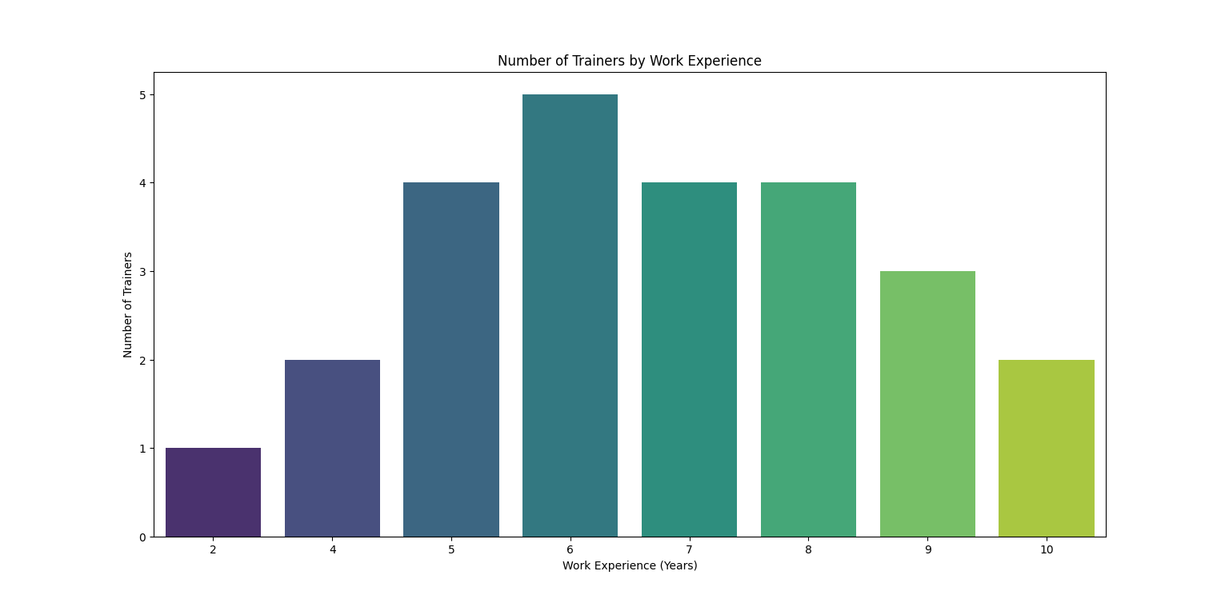
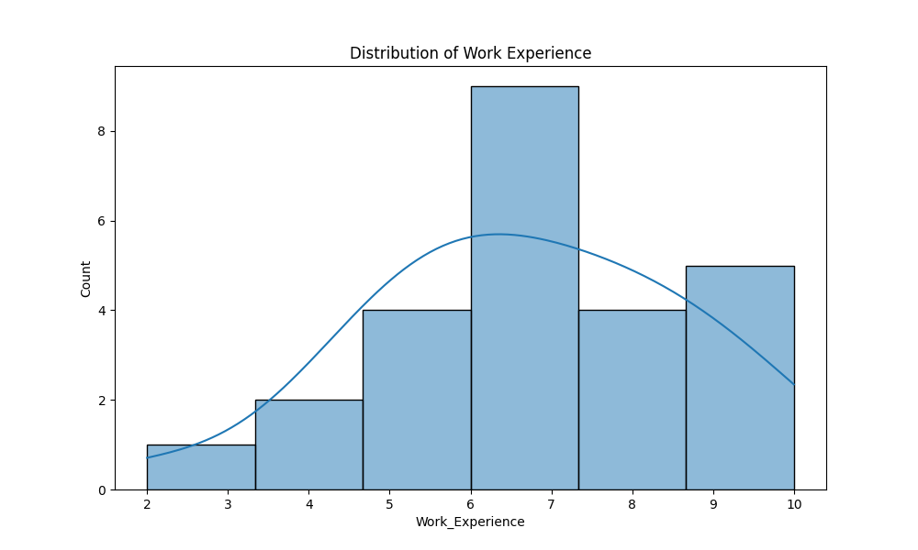
GRAPH

Slide 9
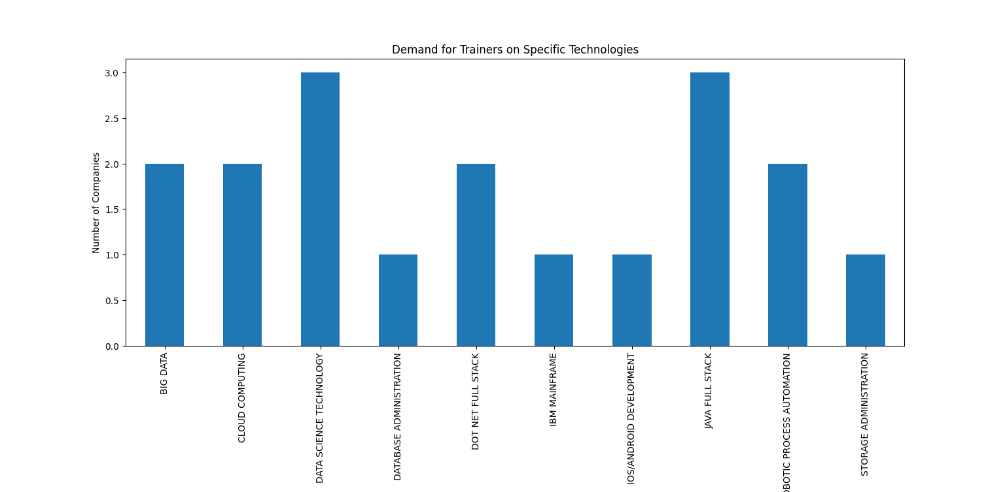
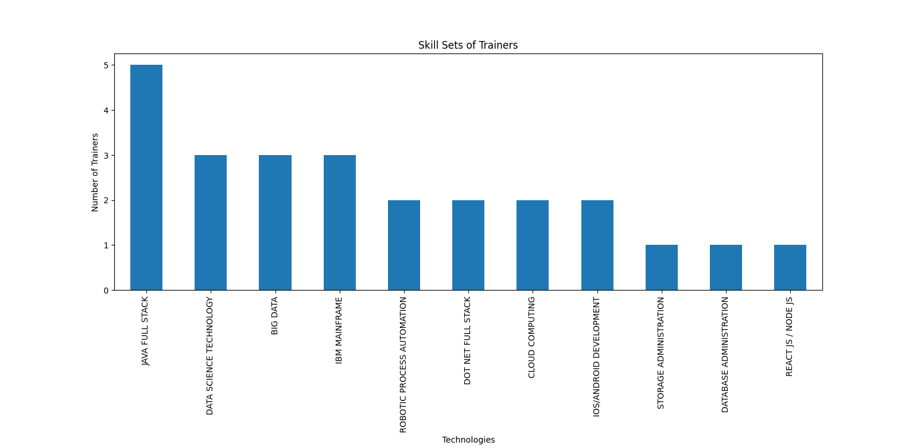
GRAPH

Slide 10
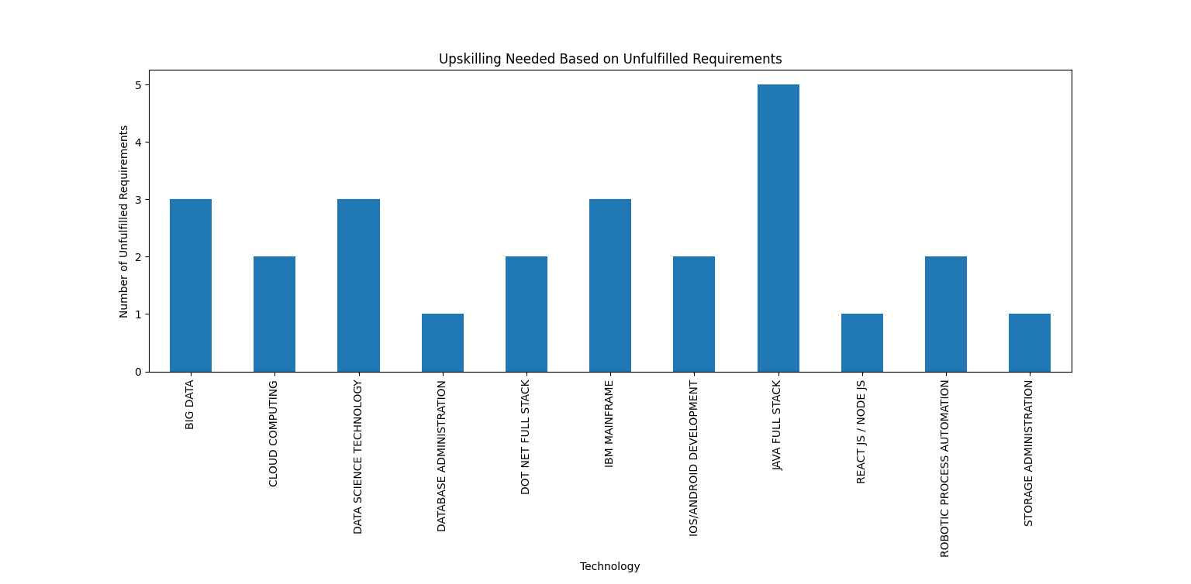
GRAPH

Slide 11
CONCLUSION
High demand for Data Science and Java Full Stack courses.
Emerging technologies like AI/ML and Cloud Computing are gaining traction.
Consultant trainers are preferred for niche training needs.

Slide 12
THANK YOU

